Slide 1

MADAN MOHAN MALAVIYA UNIVERSITY OF TECHNOLOGY
GORAKHPUR
ATM INTERFACE
Presented by:
AHMAD FARAZ ANSARI
Roll no.: 2023073006
M.C.A. 2nd Year (3rd Sem)
Under Supervision By:
MS. PRANJAL MAURYA
ASSISTANT PROFESSOR
DEPT. of ITCA

Slide 2
Contents
Abstract
Problem Statement
Need
Methodology
ATM Interface
Certificate
Advantages
Limitations
Future Work

Slide 3
Abstract
Developed an ATM Interface in Java that simulates core banking functions such as balance inquiry, withdrawals, deposits, PIN management, and transaction history, using object-oriented programming principles for a modular and efficient design.
Implemented secure user authentication, allowing users to change their PIN, and integrated transaction tracking to maintain a detailed history of deposits and withdrawals.
Designed with scalability in mind, the project can be expanded with future features like multi-factor authentication, mobile app integration, AI-driven fraud detection, and additional banking services.

Slide 4
Problem Statement
The problem addressed by this project is the need for a secure and efficient system to simulate the functionality of an Automated Teller Machine (ATM). The ATM system must enable users to perform essential banking operations such as checking their account balance, depositing and withdrawing money, changing their PIN, and viewing their transaction history. This project aims to create an ATM interface that is simple to use, reliable, and can be expanded with additional features in the future.

Slide 5
Need
To provide a secure, user-friendly interface for performing essential banking operations like balance inquiry, deposits, and withdrawals.
To ensure secure access with PIN validation, safeguarding users' financial information and transactions.
To offer an efficient transaction history tracking system, allowing users to view their past deposits and withdrawals.
To create a scalable system that can be expanded with additional features like mobile integration, AI-driven fraud detection, and more.

Slide 6
Methodology
User Authentication and PIN Validation
Balance Management and Transaction Handling
Deposit and Withdrawal Operations
Transaction History Management
System Security and Error Handling

Slide 7
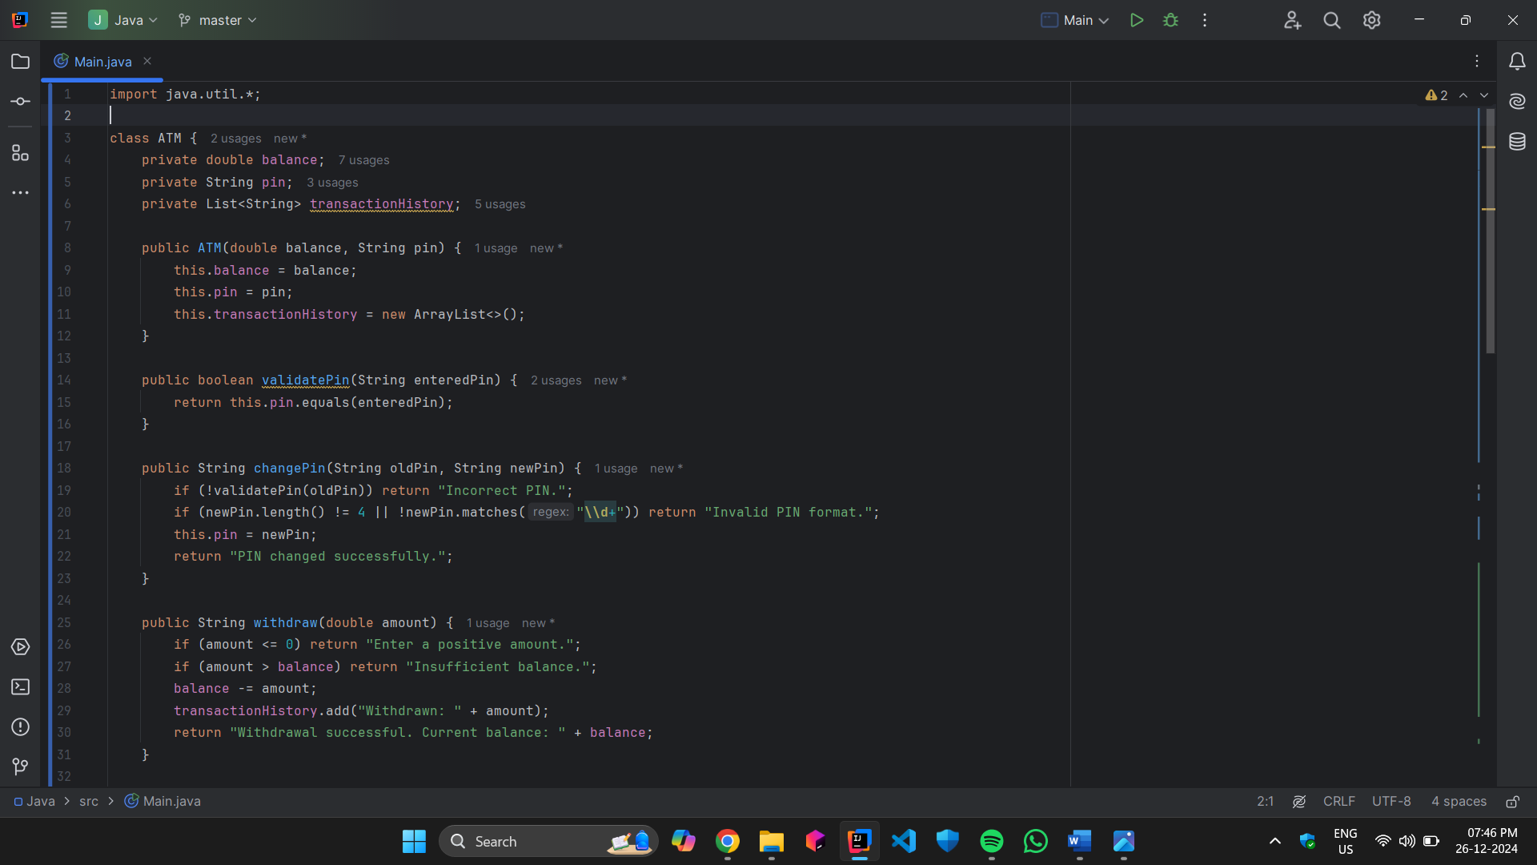
ATM Interface

Slide 8
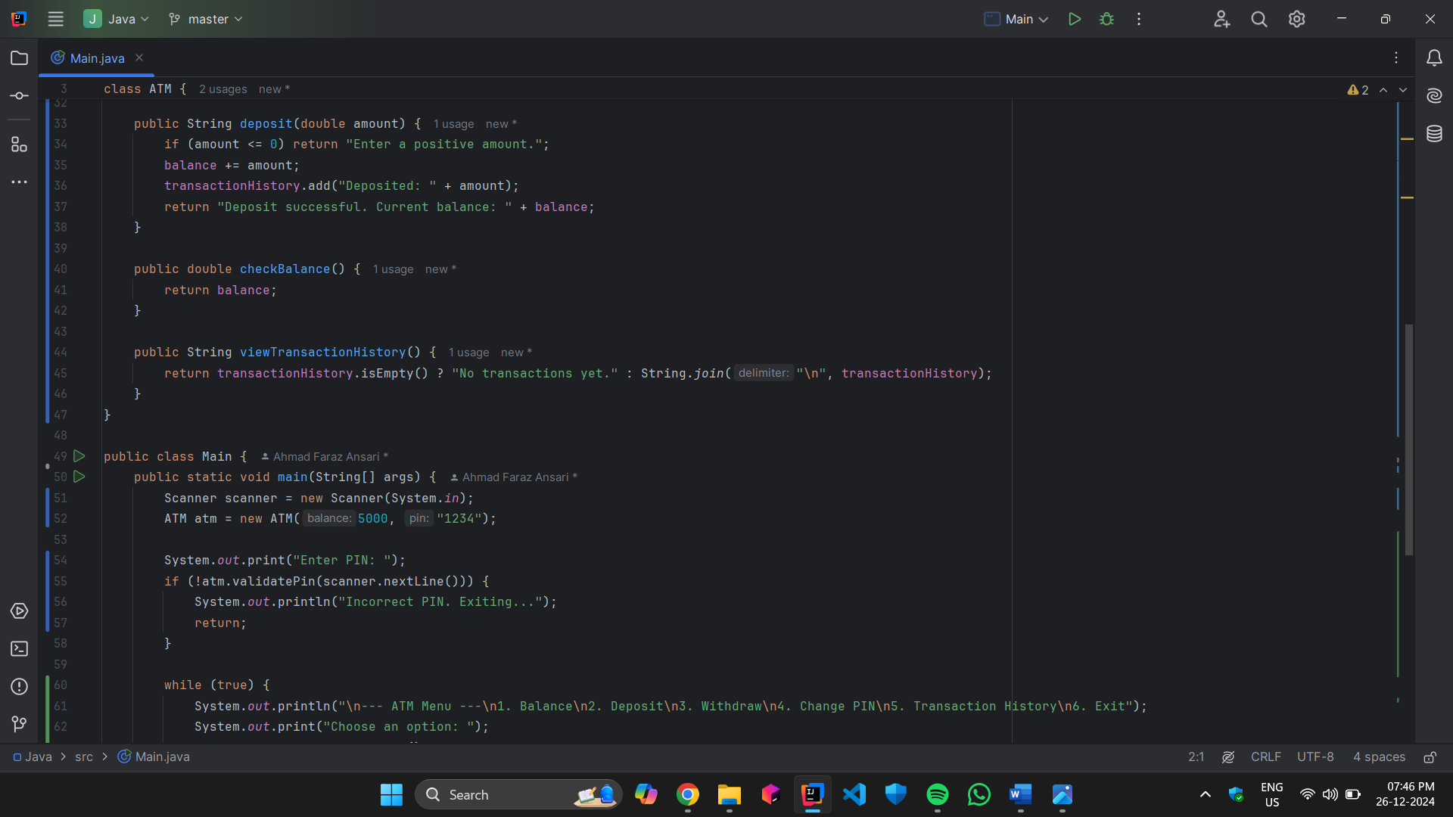

Slide 9
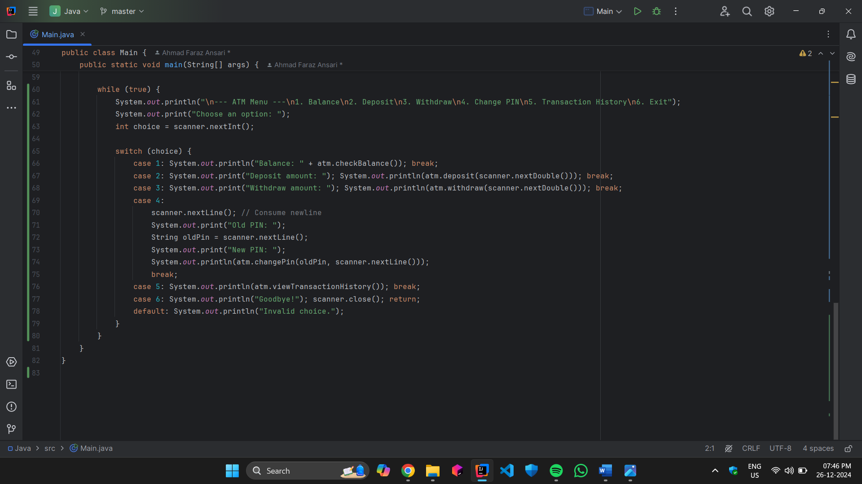

Slide 10
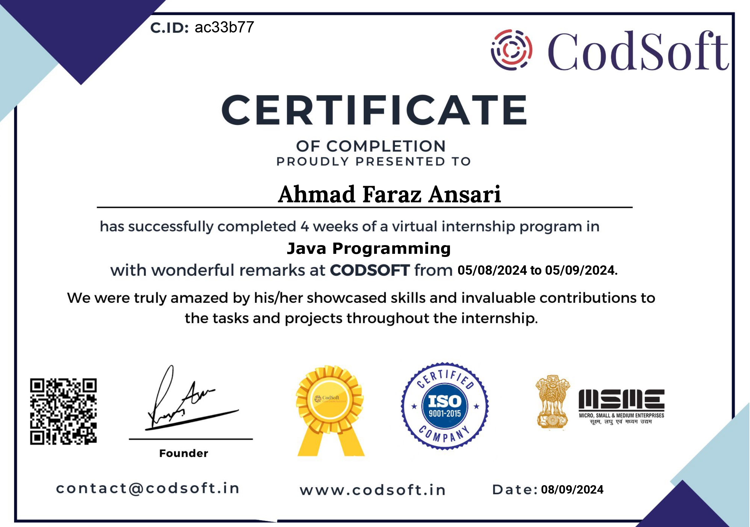
Certificate

Slide 11
Advantages
Provides a secure and user-friendly interface for performing essential banking operations like withdrawals, deposits, and balance inquiries.
Utilizes object-oriented principles for a modular, scalable, and easily maintainable system.
Ensures secure user access with PIN validation and transaction history tracking.
Offers a comprehensive learning experience in Java programming, object-oriented design, and real-world system development.

Slide 12
Limitations
Limited to basic ATM functionalities, lacking advanced features like fund transfers and bill payments.
No real-time connection to a bank server, so transactions and balance updates are not synced with actual accounts.
Lacks multi-factor authentication for enhanced security, relying only on PIN validation.
The transaction history is not persistent and is cleared once the program ends.
Cannot handle large-scale transactions or provide a high level of scalability for a commercial banking system.

Slide 13
Future Work
Integrate multi-factor authentication for enhanced security, such as biometric or SMS verification.
Implement real-time transaction processing by connecting the system to a centralized bank server.
Add advanced banking features like fund transfers, bill payments, and loan applications.
Develop a mobile application to allow users to access ATM functionalities on smartphones.
Incorporate AI-driven fraud detection and behavior analysis for improved security and user protection.

Slide 14
References
Java Programming documentation, Oracle.
"Object-Oriented Programming with Java" by R. B. Patel.
"Introduction to Java Programming" by Y. Daniel Liang.
“Design Patterns: Elements of Reusable Object-Oriented Software” by Erich Gamma et al.
Official IntelliJ IDEA documentation, JetBrains.

Slide 15
Thank You.

Slide 16
Any Question? Please feel free to ask them

